Slide 1

NEWS IDENTIFIER PROJECT
By : Hardi Dave, Dhairya Patel, and Avi Patel

Slide 2
1
INTRODUCTION
This capstone project focuses on leveraging machine learning techniques to analyze the authenticity of news shared on social media platforms.
Using Kaggle dataset to train and test the models identifying Positive & Negative News.
This project addresses the growing spread of fake news in the digital age by tackling societal challenges of confusion, mistrust, and harm caused by false information.

Slide 3
2
PROBLEM
Persona: Sarah, 28, Journalist
Quote: "In today's fast-paced media environment, it's becoming increasingly difficult to verify the authenticity of news stories before publishing."
Key Points:
Time-consuming manual fact-checking
Risk of damaging credibility by accidentally sharing fake news
Overwhelming volume of information to verify

Slide 4
3
SOLUTION
For Sarah:
AI-powered news authenticity checker
Quick analysis of articles and social media posts
Detailed reports with credibility scores and explanations

Slide 5
4
UNIQUE VALUE PROPOSITION
Key differentiators:
Advanced machine learning algorithms
User-friendly interface for quick checks
Detailed analysis reports for in-depth understanding
Continuous learning from user feedback

Slide 6
5
ADDITIONAL PERSONAS
Mark, 45, Concerned Parent
Wants to ensure his children access reliable information online
Emma, 32, Social Media Manager
Needs to verify content before sharing on company platforms
Prof. Johnson, 55, University Lecturer
Encourages students to fact-check their sources

Slide 7
6
MVP
AI-powered authenticity analysis
Basic explanation of the analysis result
User registration and login
Text input for news articles and social media posts
Credibility score display

Slide 8
7
Technologies
Tools: TextBlob and Jupyter Notebook
Technology: Python language
ML Models & Data Science : TensorFlow/Keras, Scikit-learn, NLTK, Decision Tree Classifier, XGBoost, KNN, Pandas and Numpy

Slide 9
8
USER STORIES
“As a concerned citizen, I want to quickly verify the authenticity of the news articles I come across, so that I can avoid sharing misinformation with my friends and family”
“As a journalist, I want to see a detailed breakdown of why content was classified as fake or real.”
“As a student, I want to verify the information I use in my research papers, so that I can confidently cite reliable sources and improve the quality of my academic work.”

Slide 10
9
PROJECT BACKLOG
High Priority:
Data preparation and model training
Basic web interface
User authentication
Medium Priority:
Analysis report
URL input support

Slide 11
10
TEST CASES
Input Validation:
Test with various text lengths
Test with special characters and different languages
Authentication:
Test user registration with valid/invalid inputs
Test login with correct/incorrect credentials
Analysis Accuracy:
Test with known fake news dataset
Test with known real news dataset
Performance:
Test response time for analysis
Test concurrent user handling

Slide 12
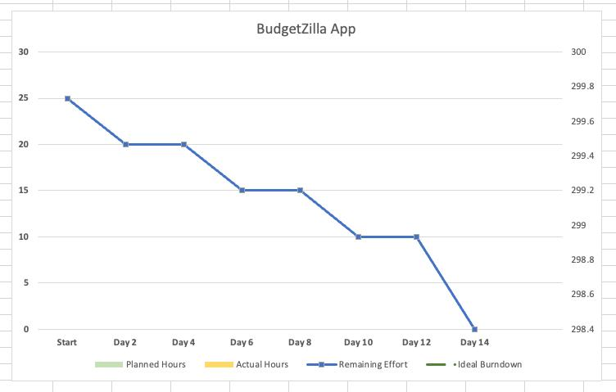
11
SPRINT BURNDOWN CHART

Slide 13
12
RETROSPECTIVE
What Went Well:
Data Collection & Pre-Processing
Good Teamwork, Taking iterative approach allowed for flexibility and adaptation to changing project needs.
Areas for Improvement:
Underestimated time for data cleaning
Need to improve test coverage for dataset

Slide 14


